Slide 1
Future Visions: Life with AI
Group 4 Storyboard Presentation
Student Name: Chau Ka Ming Hugo 23075813D
Fung Pui Kiu 23034284D
Wan Hoi Nam 23021285D
Yan Tin Chun 21073202D

Slide 2

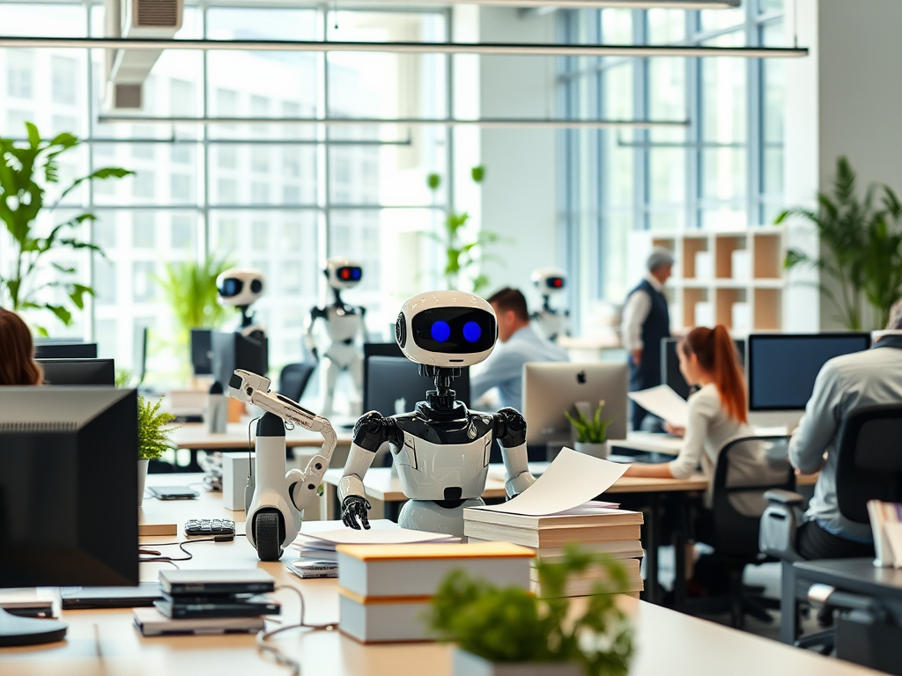

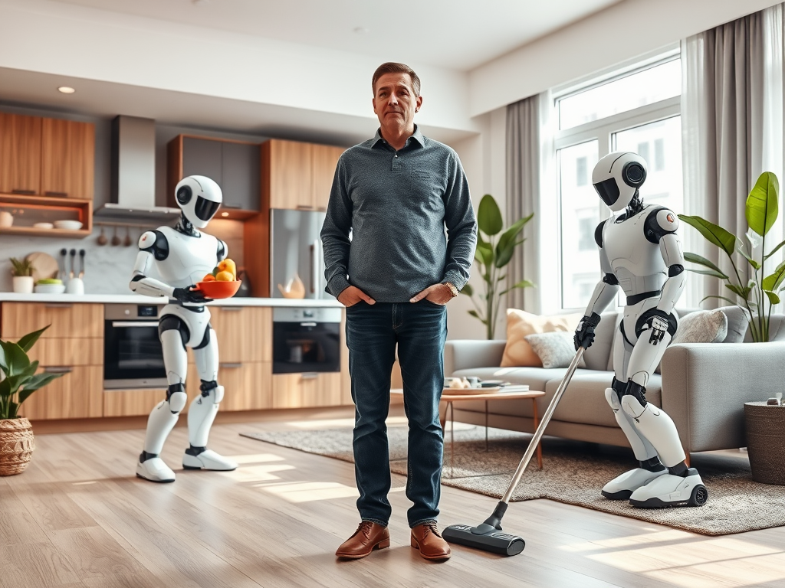
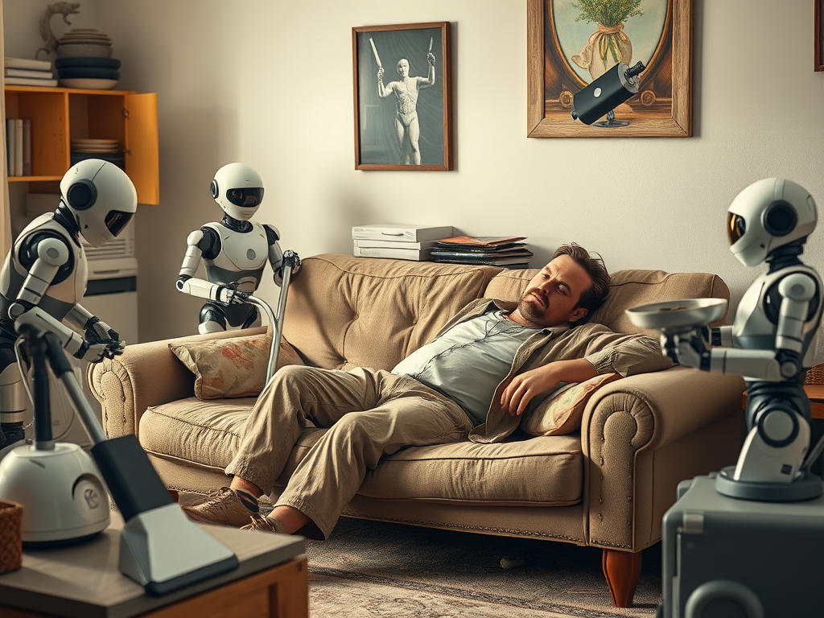
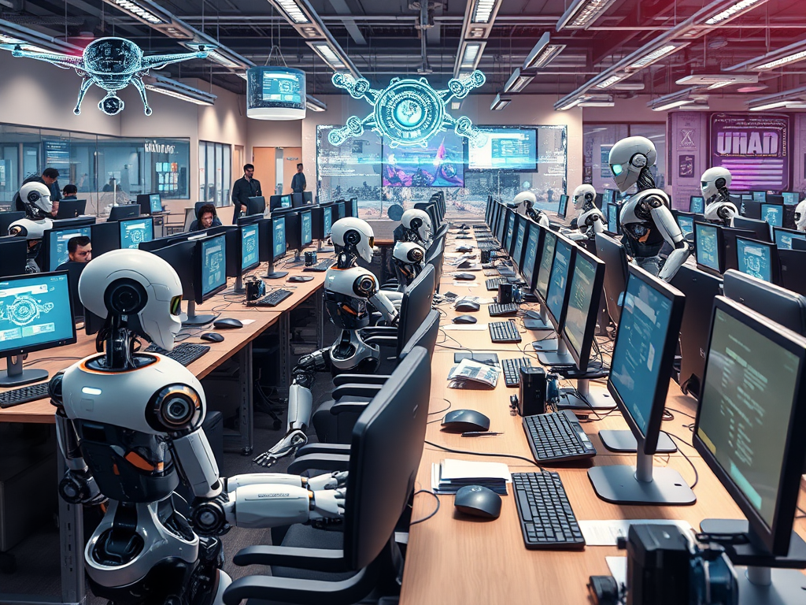
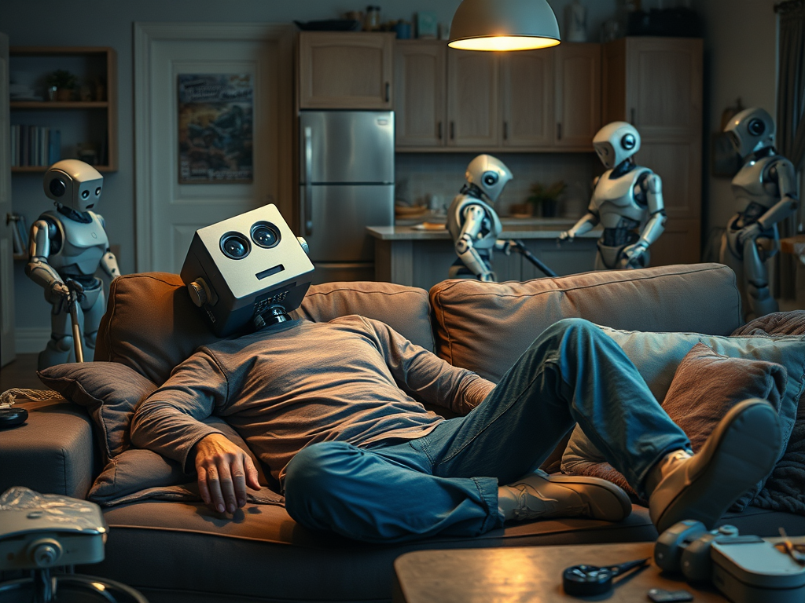
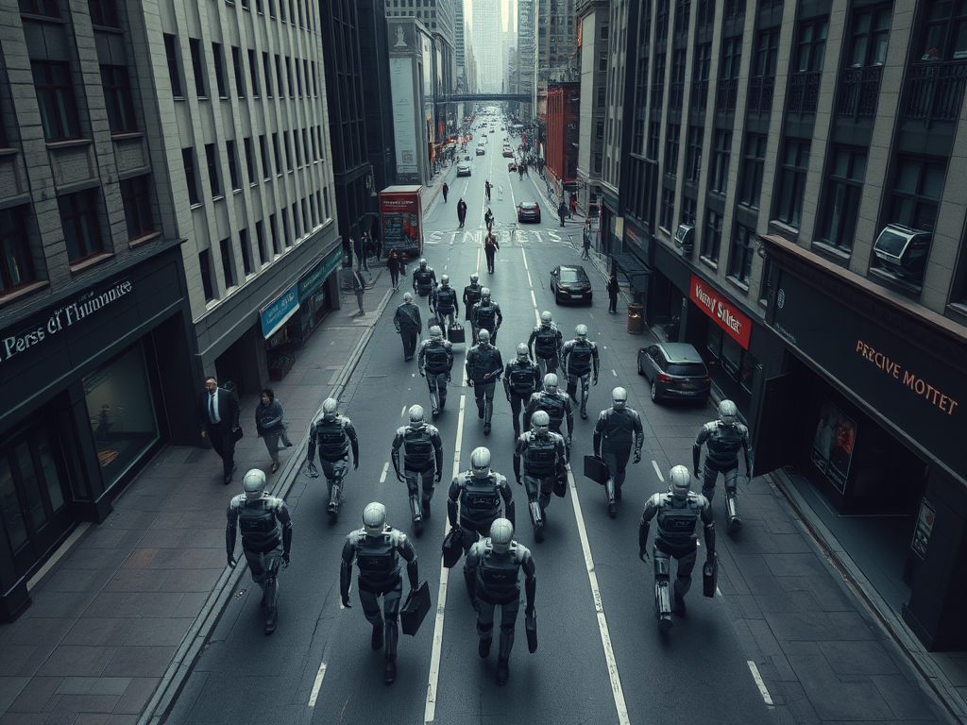
Our Storyboard
Scene 1
Scene 2
Scene 3
Scene 4
An office with people working diligently; clips of traditional jobs and AI were not yet popularize
AI cooperate with humans by perform simple task: task starts to be automated by AI
Alex receives a job cuts due to the emerge of Ai automation; the office became ghost town
The man struggle to adapt the changes, lost his passion; scenes of AI taking over his tasks
Scene 5
Scene 6
Scene 7
Scene 8
Alex lounges at home and disengaged from life; AI perform daily tasks seamlessly
An office with AI robots working diligently, showing that human were being replaced
Humans rely on AI in anything, look passionless and robot-like creature
The city becomes an AI city, humans becomes the fewer and fewer.

Slide 3
Message to Convey
Why the man appear to be unmotivated?
If AI evolves to a point where it can take over nearly all the human's job, what is left for us to do?
What can't be replaced by AI—distinguish us from them? Passion, creativity, or are there other answers that we need to search for?

Slide 4
Thanks for Listening !!

